Slide 1
Midterm Project Proposal
Nashra Zaman

Slide 2
Portfolio - Main Page
Nashra Zaman
Picture
About me

Slide 3
Space for Resume Information
Experience and Education
University
Major
Minor
LinkedIn

Slide 4
Image
My Works
Illustrator/Photoshop
Description
Image
Image
Description
Description

Slide 5
My Works
Procreate

Slide 6
Project # 1
Image
Description
Image

Slide 7

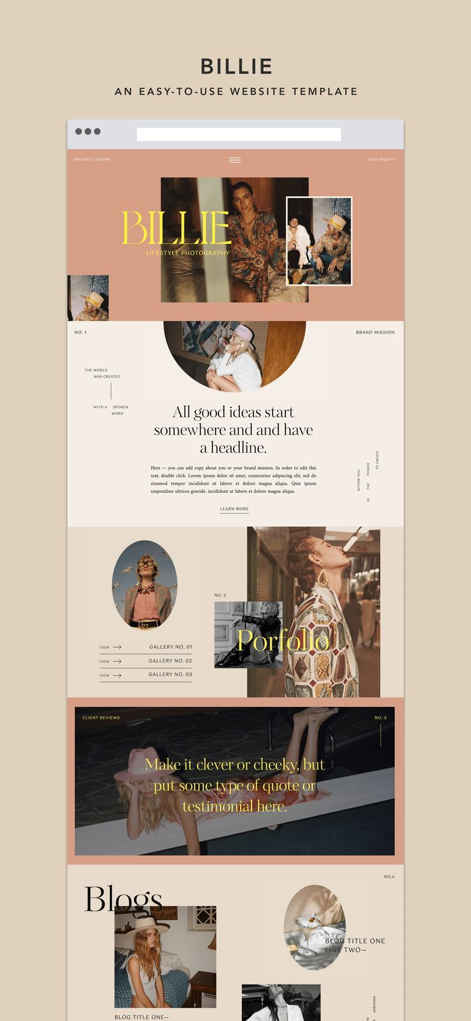
Inspo

Slide 8
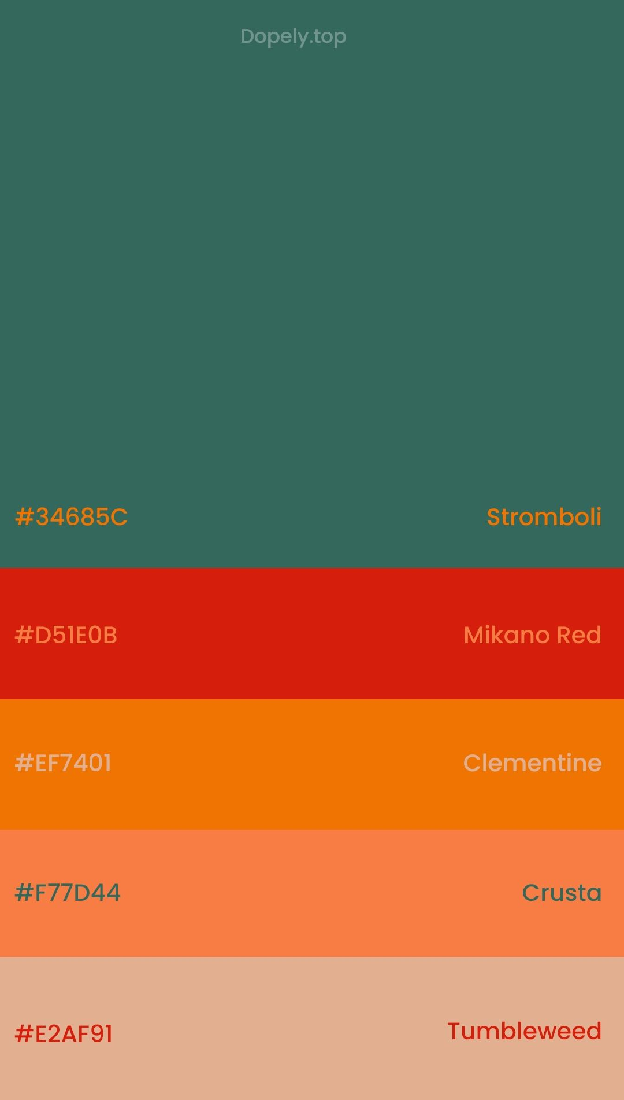

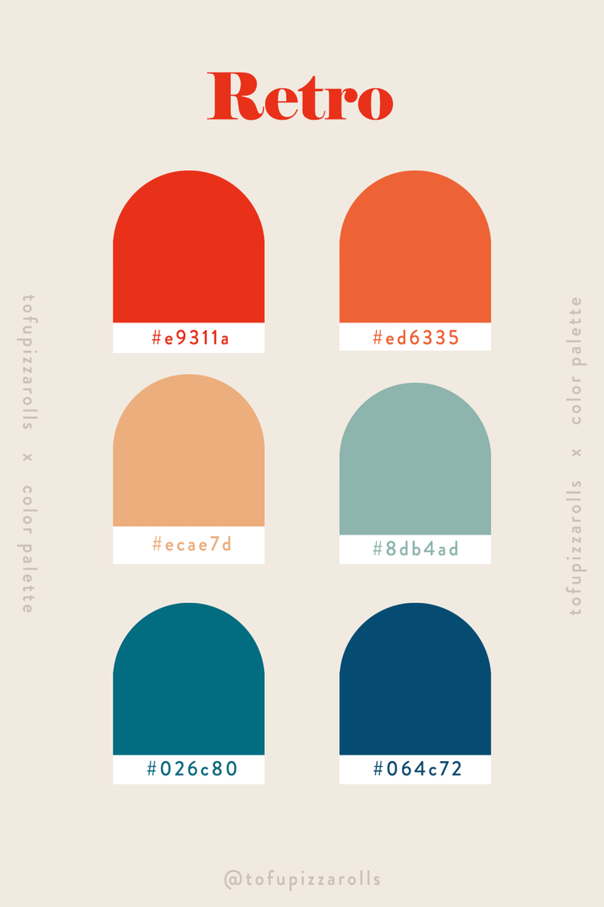
Color Palette

